Slide 1
Topological acoustic sensing using the geometric phase Keith Runge* and Pierre A. Deymier Acoustical Society of America 2024, Ottawa

Slide 2


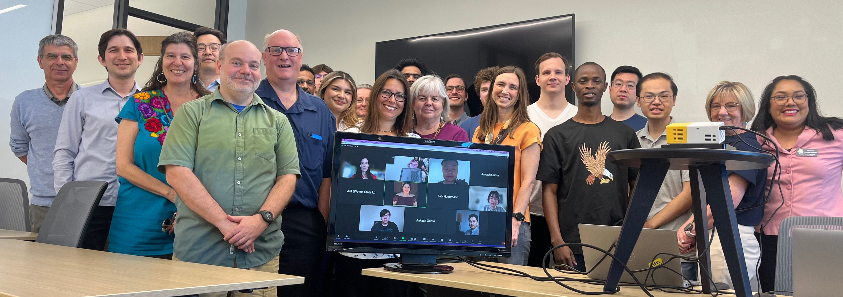
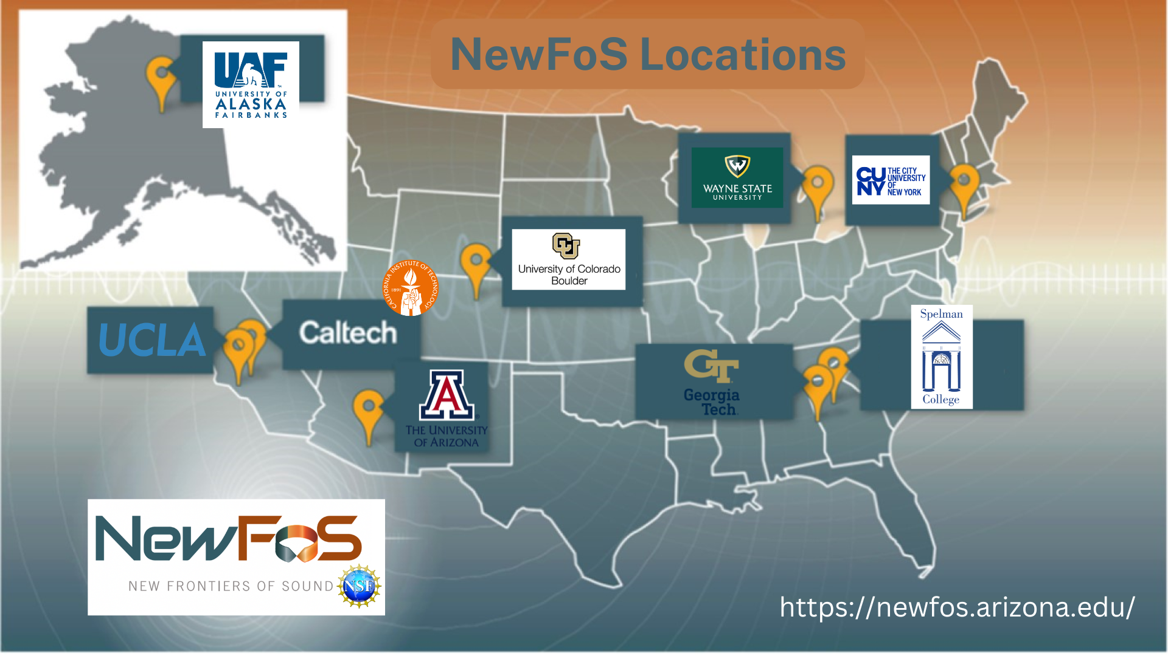






NSF cooperative agreement # 2242925
https://newfos.arizona.edu/
@NewFoS_STC

Slide 3
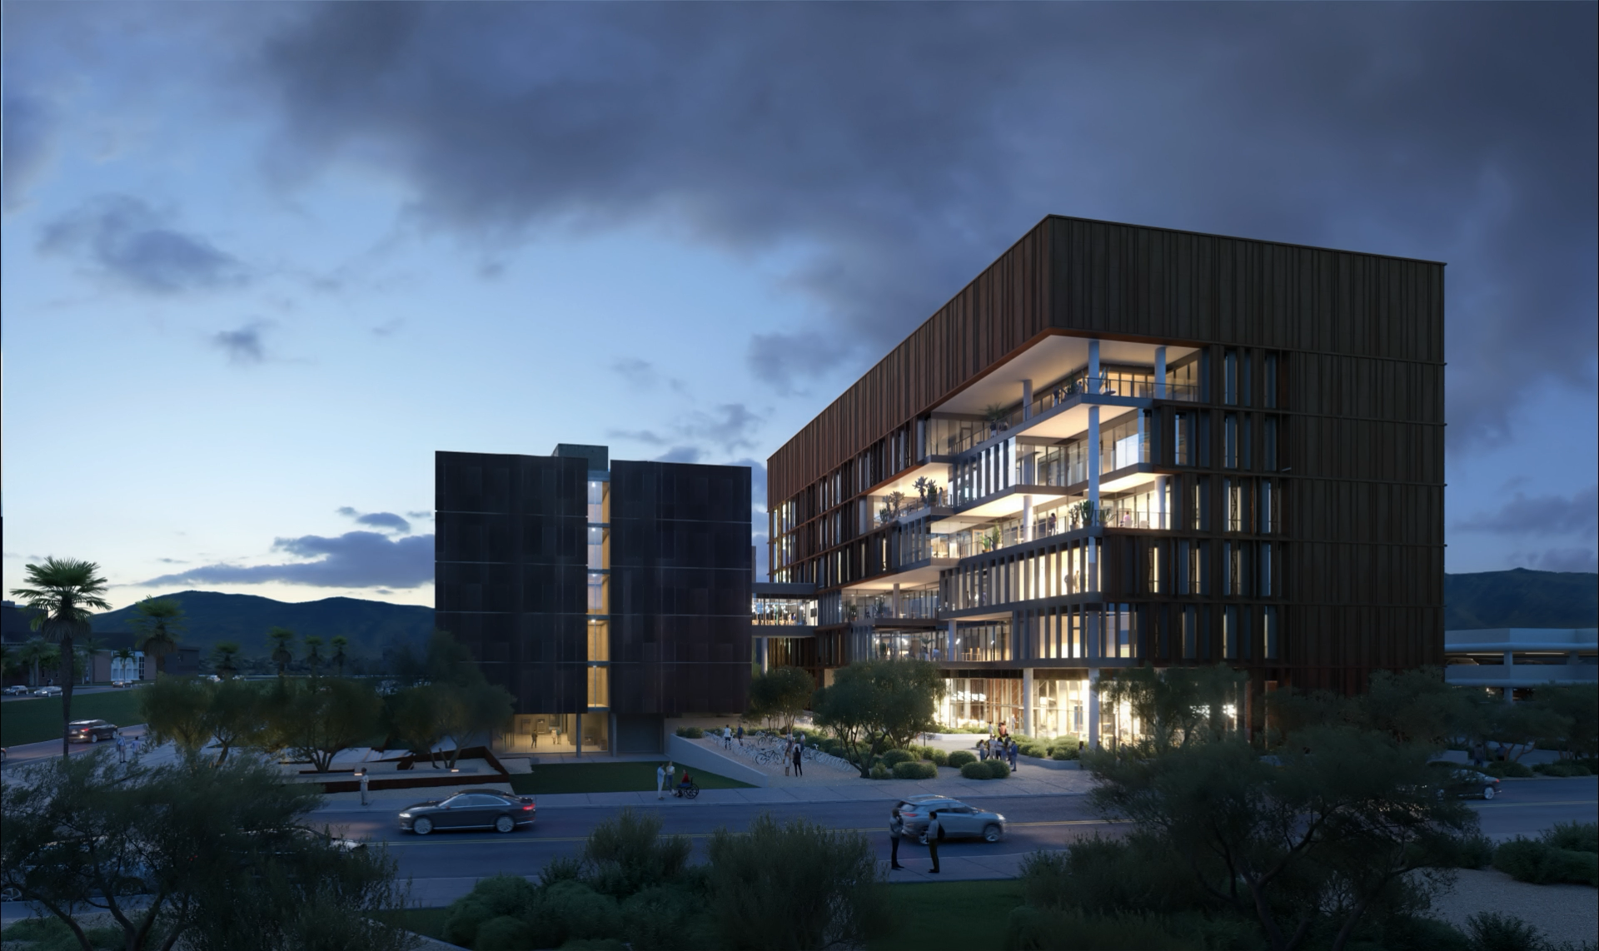
AAAAA@arizona.edu
https://newfos.arizona.edu/

